Slide 1
SDL as an Object Oriented Language
Lecture 6
Huma Ayub
Software Engineering Department

Slide 2
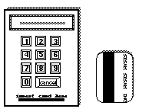
Introduction to the example
Figure : Panel and card of an access control system
The purpose of access control systems is in general to control the access to some service to people with known identity, represented by cards and personal codes.
In this specific example the system shall control access to access zones by controlling the opening of doors.
Each card holds a unique Card-code that identifies the card. To grant access the system will read the Card-code and then check the corresponding access right. For additional authentication, the user will be asked to enter the secret personal number (PIN).

Slide 3
Introduction to the example
A typical access control system will consist of a number of access points and a central unit where validation is performed
Some access points are so-called blocking access points, that is access points that may be blocked by an operator, so that access is denied even with a valid card and code, until the access point is enabled again. Other access point may have the property that they log what is going on at the point.

Slide 4
Introduction to the example
In order to illustrate as many mechanism of SDL as possible, the example system will consist of three sets of access points, each of a different type. In a real access control system one may choose to give all access points the possibility of being blocked and of logging

Slide 5
SDL Entity kinds
SDL defines the following different kinds of entities:
packages | signal routes | processes
system | signals | process types
system types | gates | services
blocks | timers | service types
block types | block substructure
channels | channel substructures

Slide 6
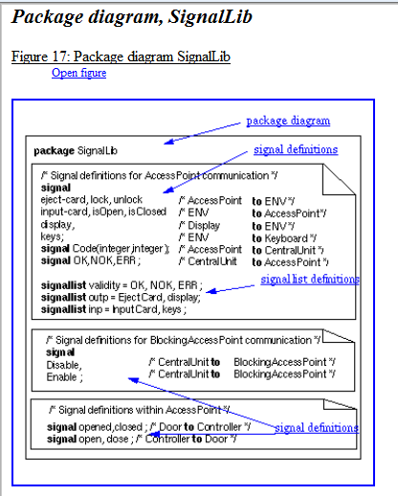
Pp Package
A package is a set of types

Slide 7
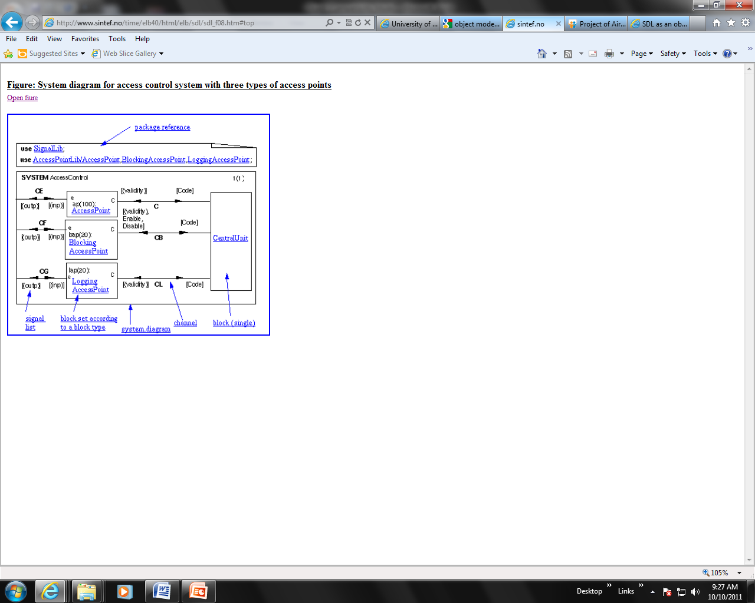
A package is a set of types
A package reference clause specifies that a system diagram or package diagram use the definitions of other packages. The names following the "/" after the package name denotes the subset of the definitions that are used

Slide 8
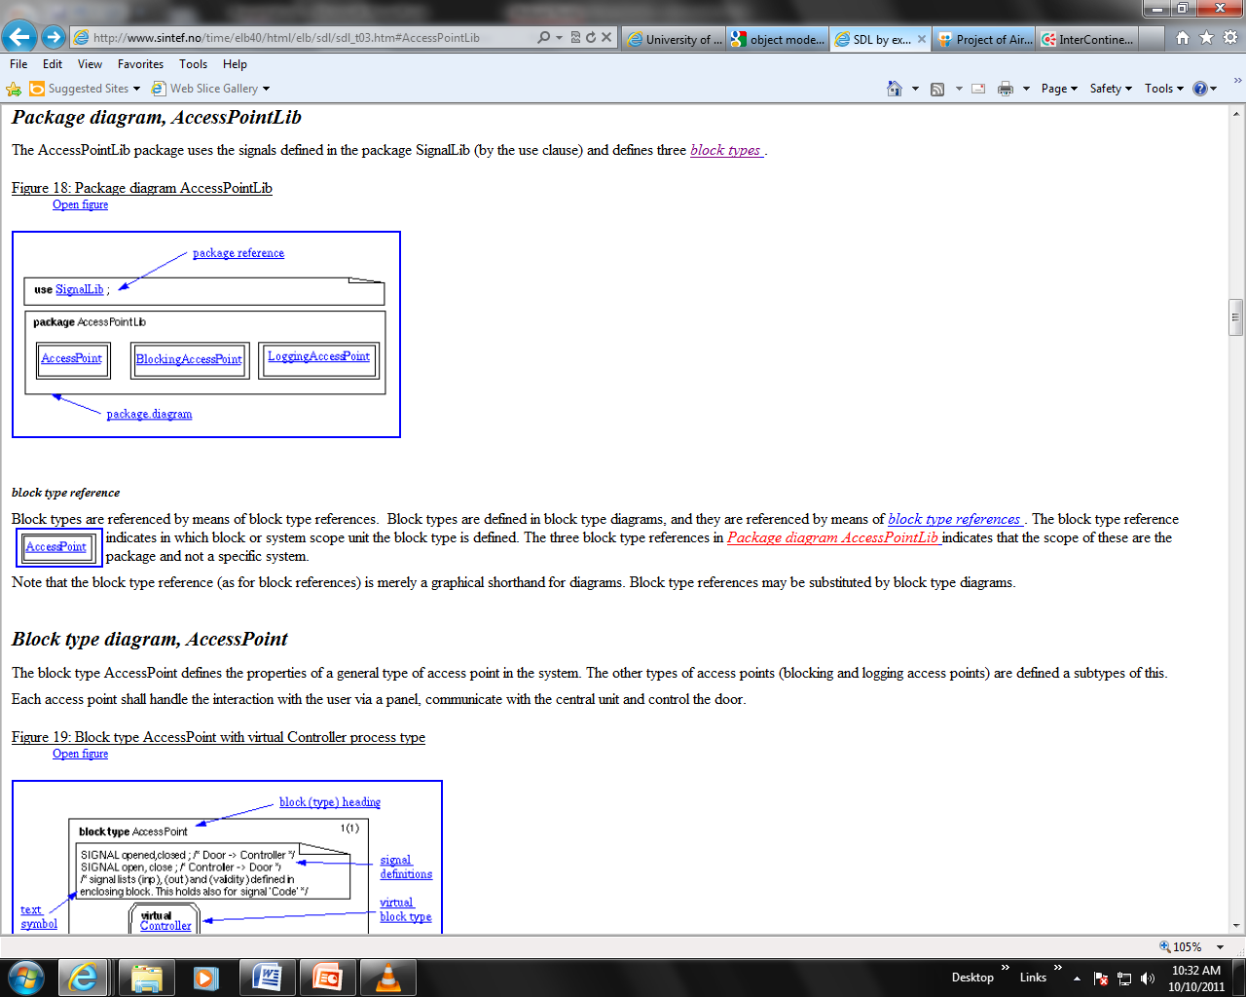

Slide 9
System
A system is in general a set of blocks , block sets and channels. Blocks and block sets are connected with each other or with the environment of the system by means of channels .
In SDL a system is defined by means of a system diagram. By making a system diagram it has been decided what is part of the system and what is part of the environment of the system

Slide 10
System
This Access Control system consists of one single block (CentralUnit) and three block sets , that is sets of blocks according to block types, connected by channels . It communicates with the environment that is supposed to behave like processes representing the users of the system, the operators and the controlled physical panels and doors at the access points.

Slide 11
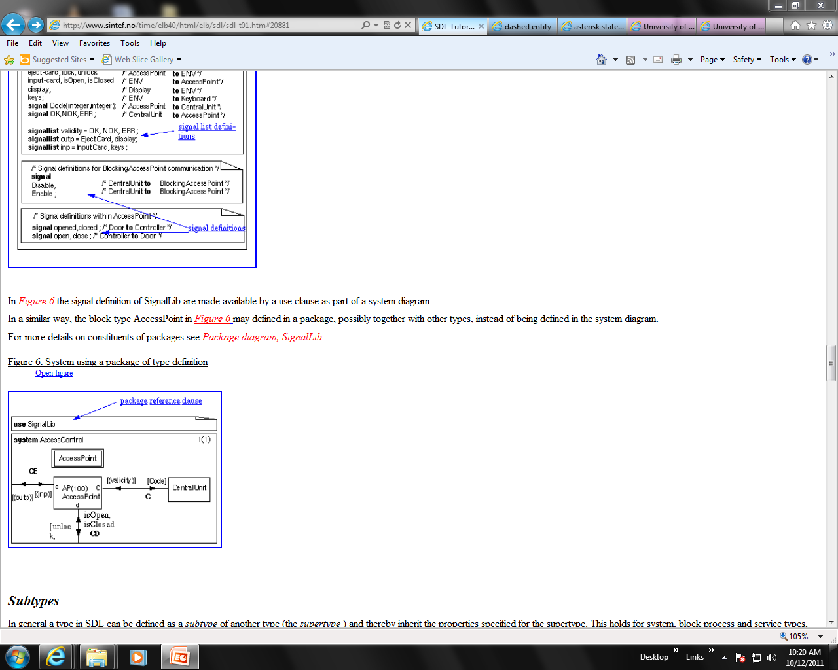
SYSTEM

Slide 12
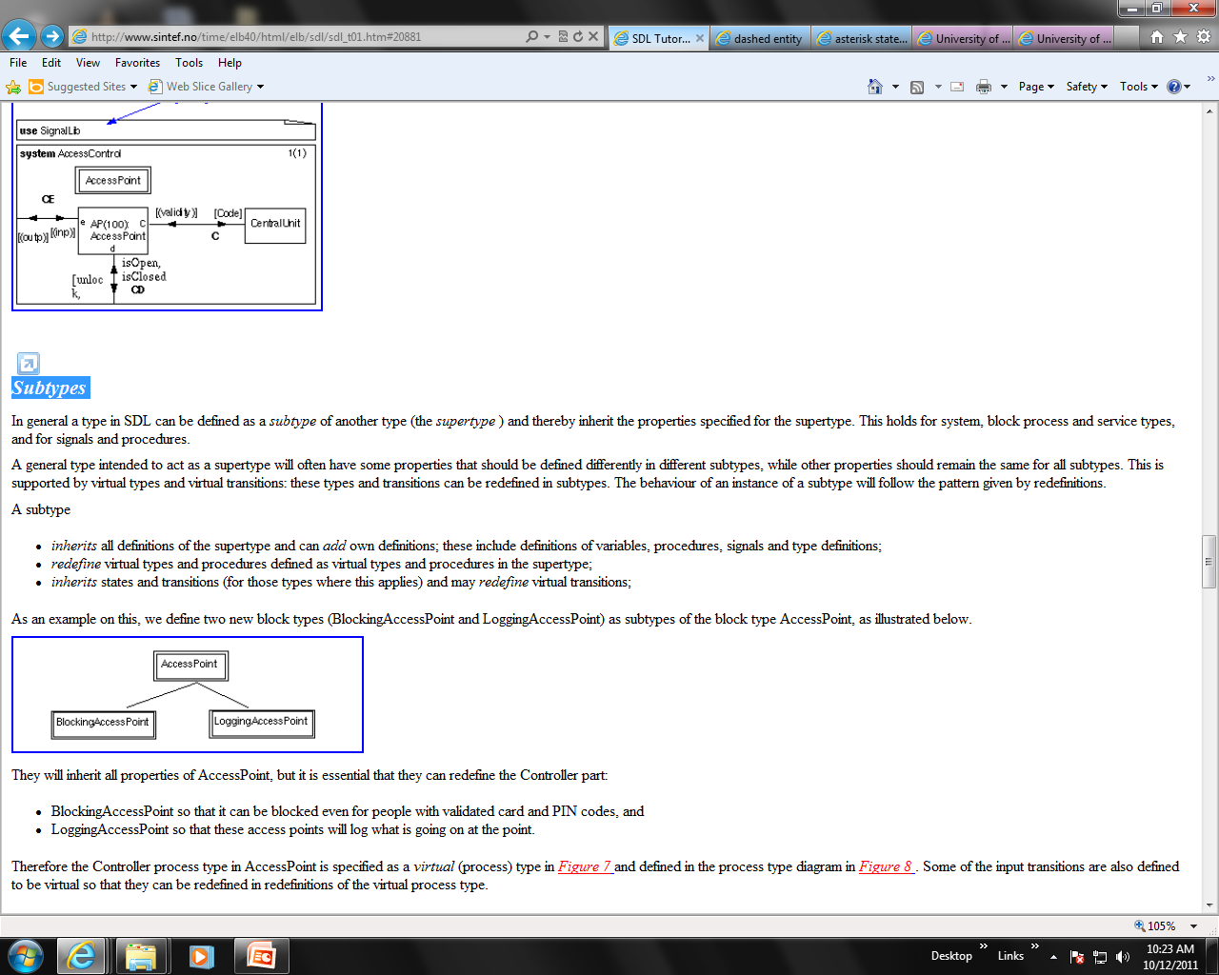
Subtypes
They will inherit all properties of AccessPoint, but it is essential that they can redefine the Controller part:
BlockingAccessPoint so that it can be blocked even for people with validated card and PIN codes, and
LoggingAccessPoint so that these access points will log what is going on at the point.

Slide 13
Environment
For the system the environment consists of a set of SDL processes that may send signals to the system and which may receive signals from the system. The signals for this purpose are defined in the system or, as here, in a package ( Package diagram, SignalLib ) used by the system

Slide 14
Block
A block is created as part of the creation of the enclosing block or system. All blocks are created as part of the system creation, that is there is no dynamic creation of blocks.
The block type AccessPoint defines the properties of a general type of access point in the system. The other types of access points (blocking and logging access points) are defined a subtypes of this.
Each access point shall handle the interaction with the user via a panel, communicate with the central unit and control the door

Slide 15
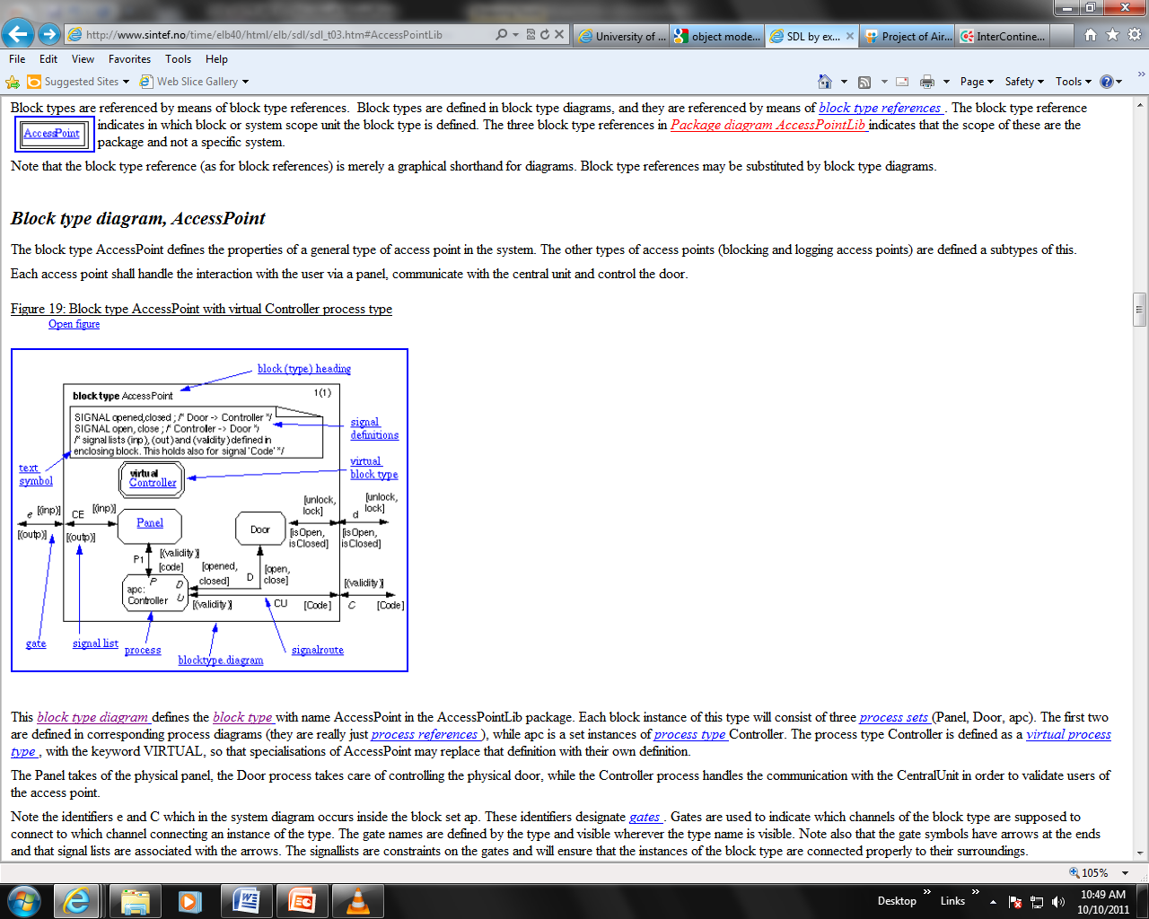
Block type diagram, Access Point

Slide 16
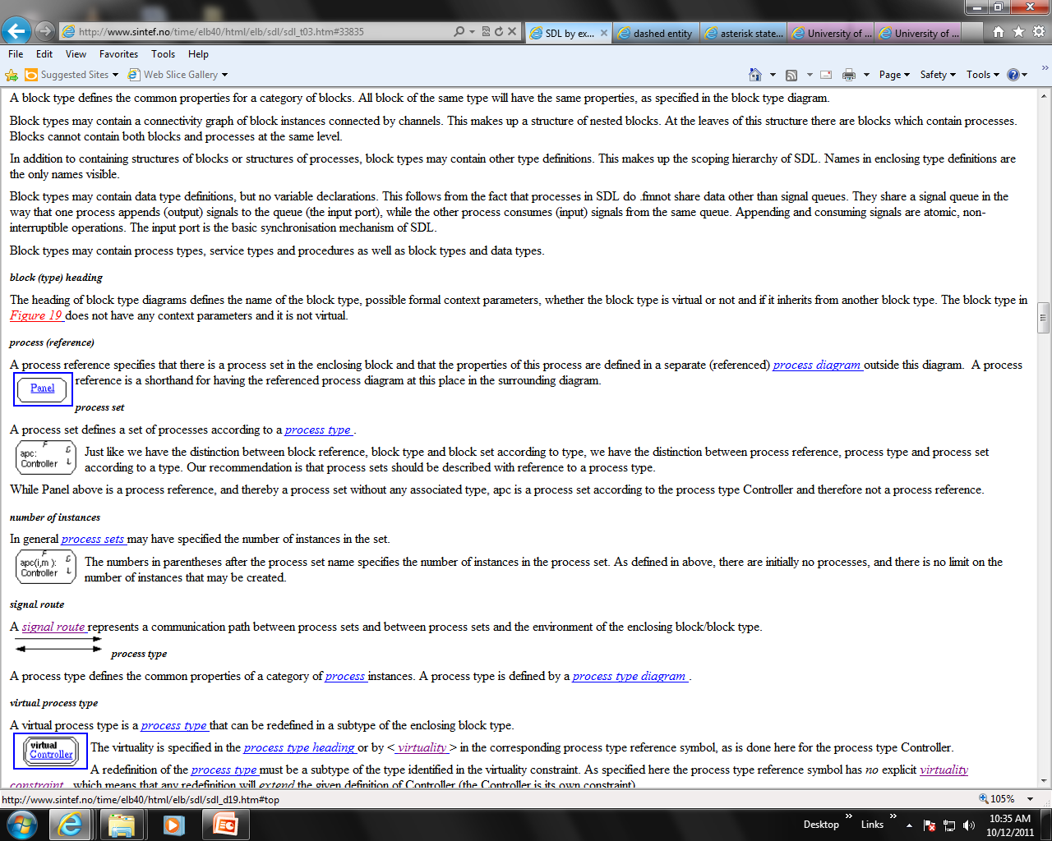
Block type diagram
process (reference)
A process reference specifies that there is a process set in the enclosing block and that the properties of this process are defined in a separate (referenced) process diagram outside this diagram. A process reference is a shorthand for having the referenced process diagram at this place in the surrounding diagram.
process set
A process set defines a set of processes according to a process type .
Just like we have the distinction between block reference, block type and block set according to type, we have the distinction between process reference, process type and process set according to a type.
While Panel above is a process reference, and thereby a process set without any associated type, apc is a process set according to the process type Controller and therefore not a process reference.

Slide 17
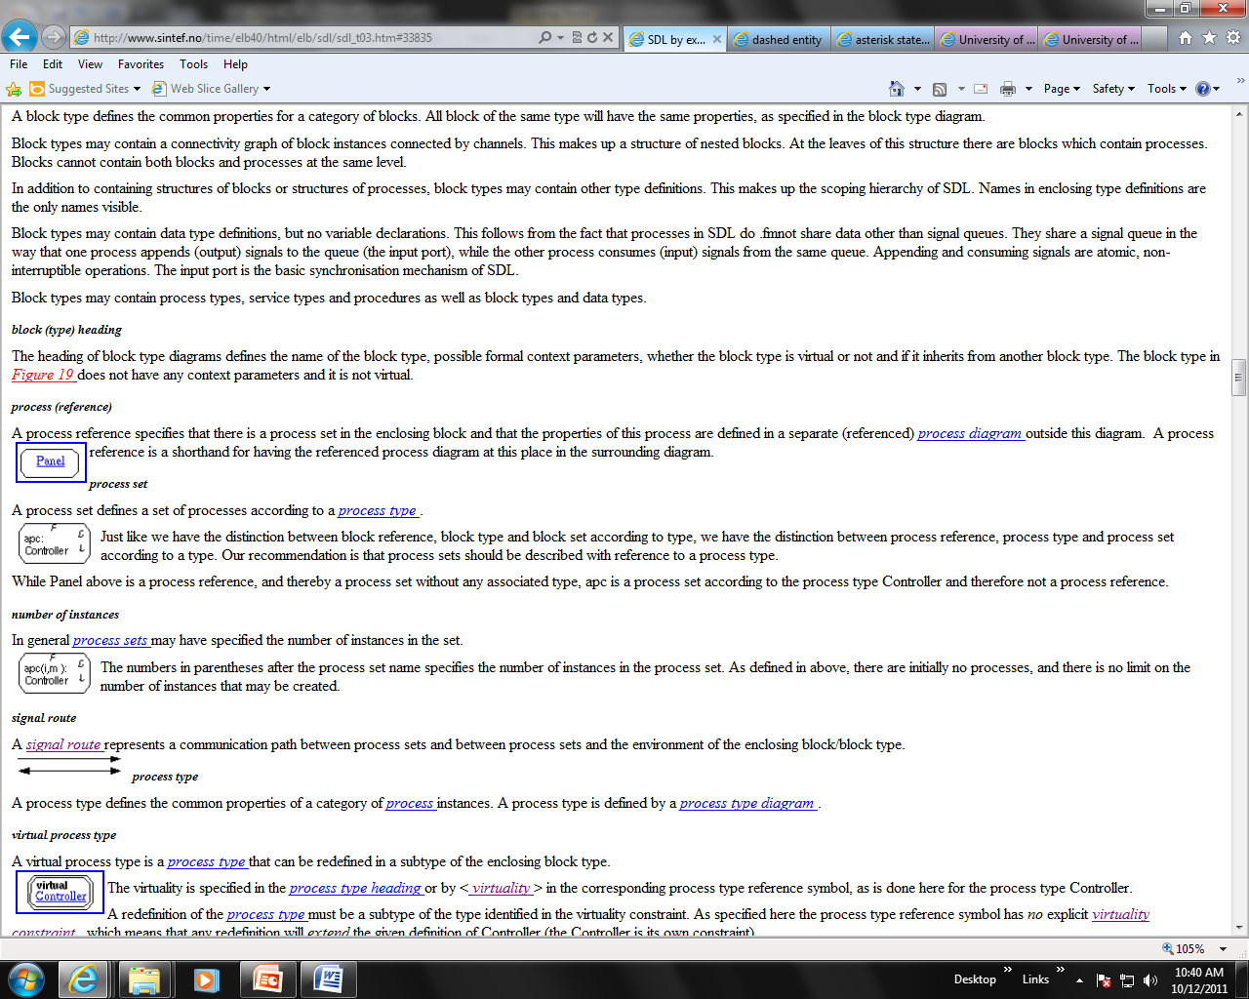
Block type diagram
In general process sets may have specified the number of instances in the set.
The numbers in parentheses after the process set name specifies the number of instances in the process set. As defined in above, there are initially no processes, and there is no limit on the number of instances that may be created.

Slide 18
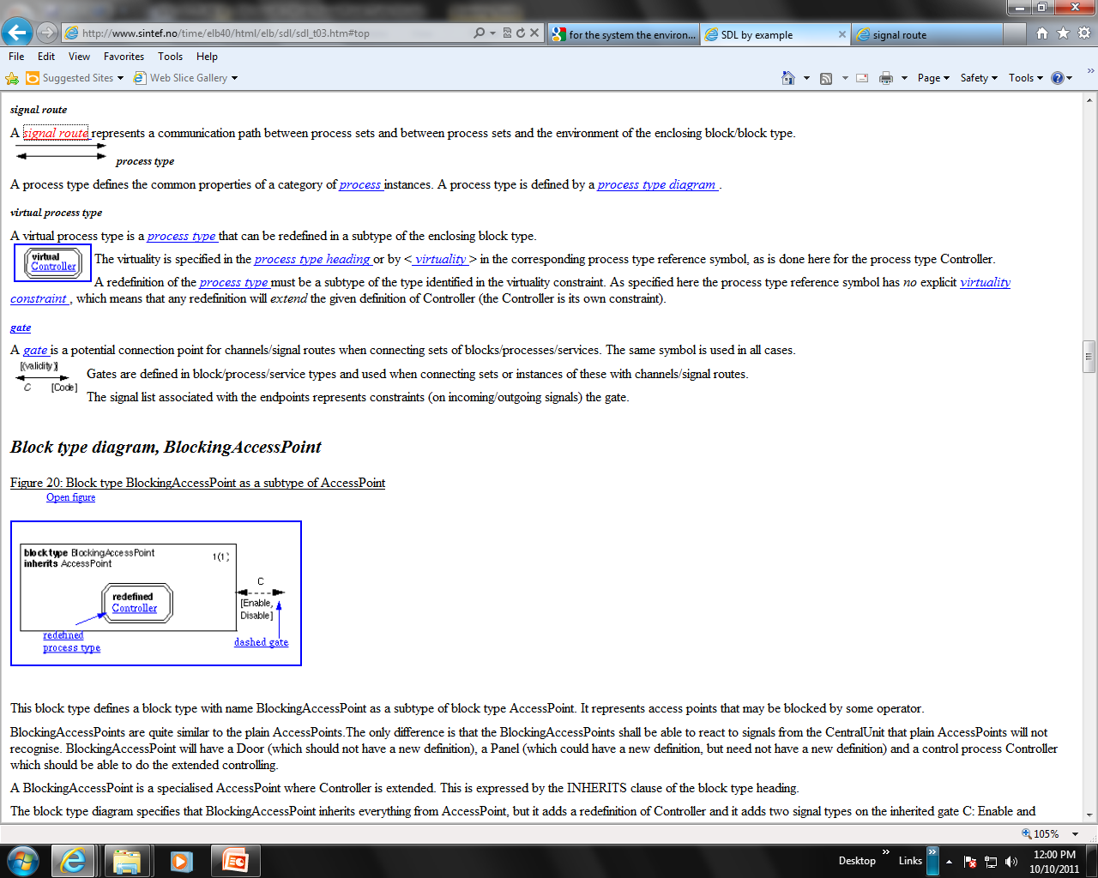
BlockingAccessPoints are quite similar to the plain AccessPoints.The only difference is that the BlockingAccessPoints shall be able to react to signals from the CentralUnit that plain AccessPoints will not recognise. BlockingAccessPoint will have a Door (which should not have a new definition), a Panel (which could have a new definition, but need not have a new definition) and a control process Controller which should be able to do the extended controlling. A BlockingAccessPoint is a specialised AccessPoint where Controller is extended.
A dashed entity is the graphical way of representing an entity that is inherited from a super type and which needs to be used in the definition of the subtype and also called existing entity .

Slide 19
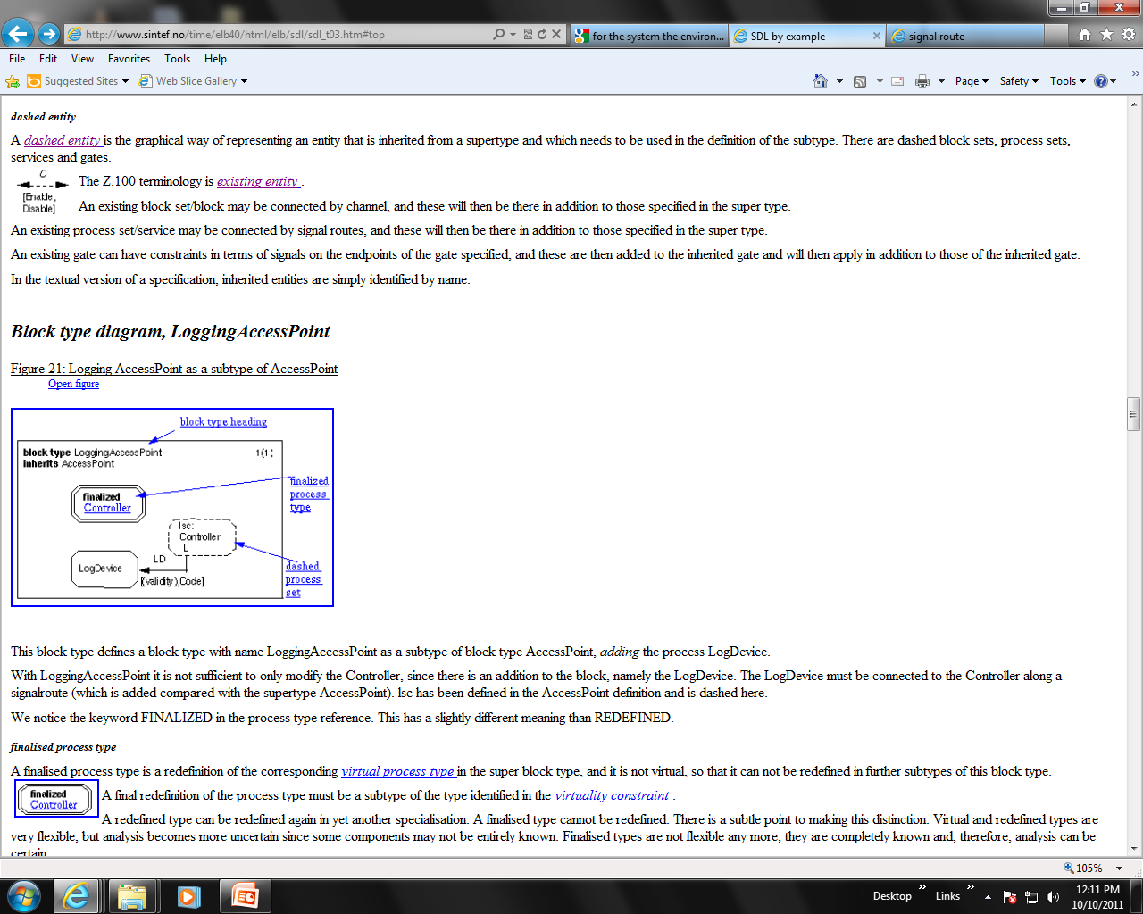

A finalized process type is a redefinition of the corresponding virtual process type in the super block type, and it is not virtual, so that it can not be redefined in further subtypes of this block type.

Slide 20
Process
A process type diagram defines the properties of a process type. A process type defines the common properties of a category of process instances. A process type is defined by a process type diagram .

Slide 21
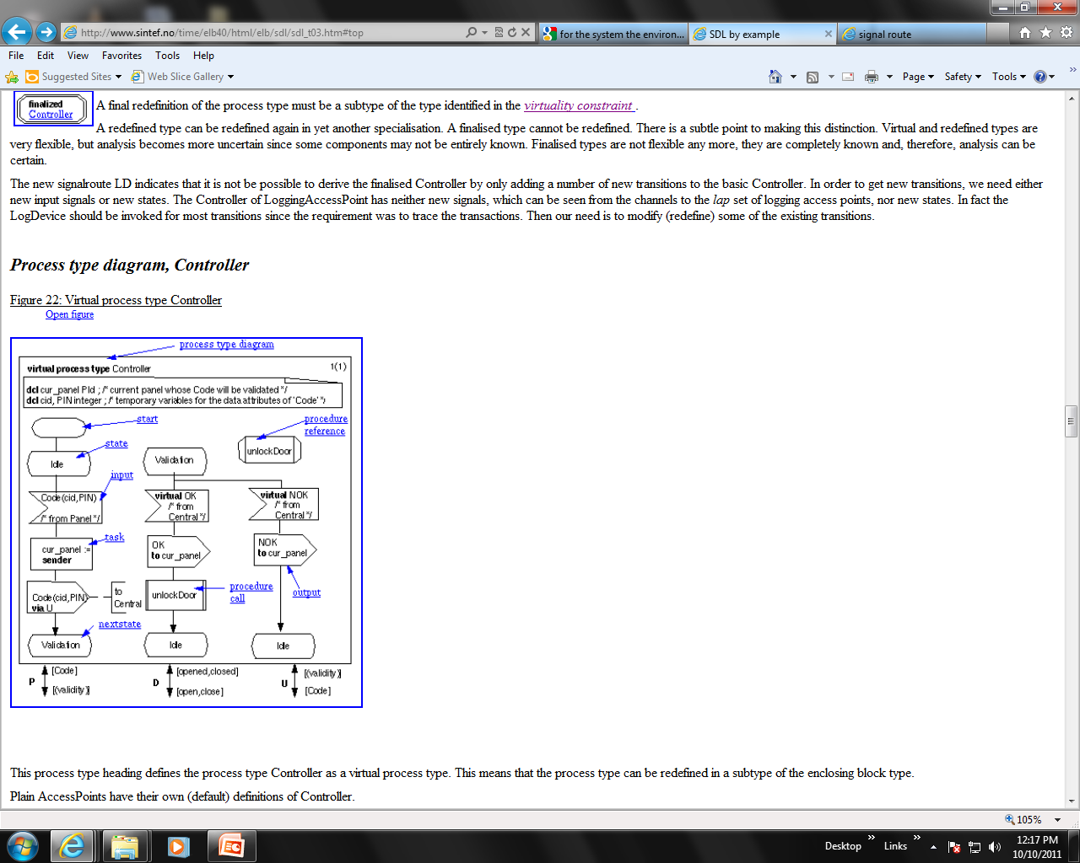
input symbols (here Code, containing information about the card id and PIN from the Panel). The Idle state is followed by one input symbol which describes the consumption of the signal Code. In the transition following the reception of the Code signal, it will use the variable cur_panel to remember from which panel the signal came from and then send the Code to the central unit for validation. The next state is Validation. In state Validation the Controller will only accept OK or NOK. If it gets OK it will open the door by calling the procedure OpenDoor.
A virtual input transition is a special case of a general notion of virtual transition:
virtual priority input,
virtual start,
virtual spontaneous transition.

Slide 22
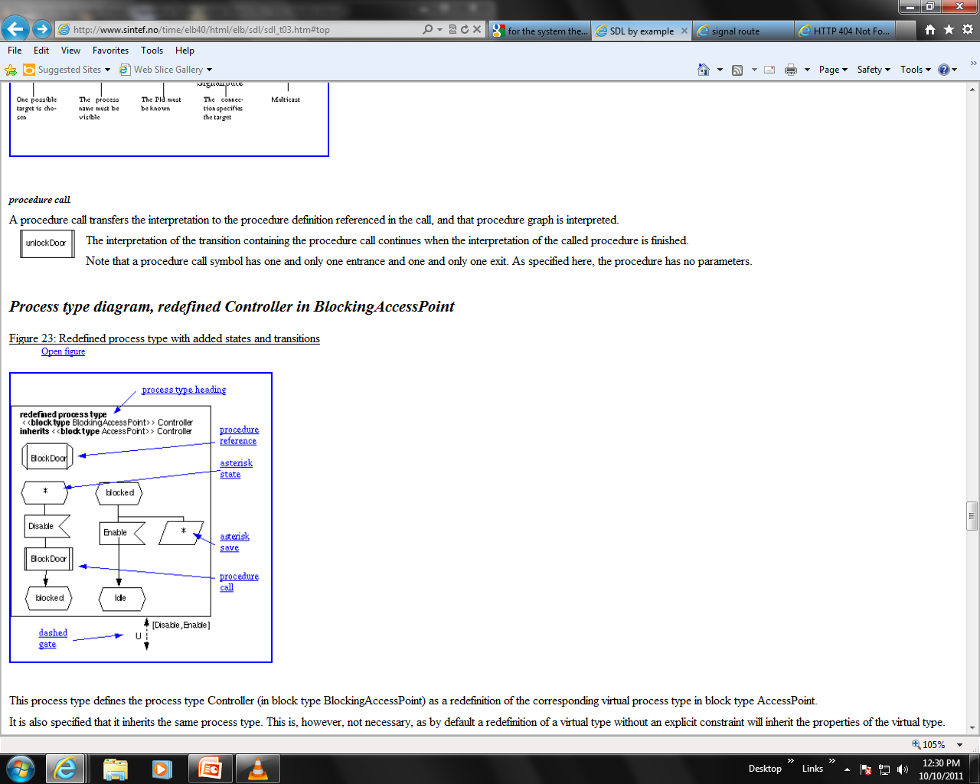
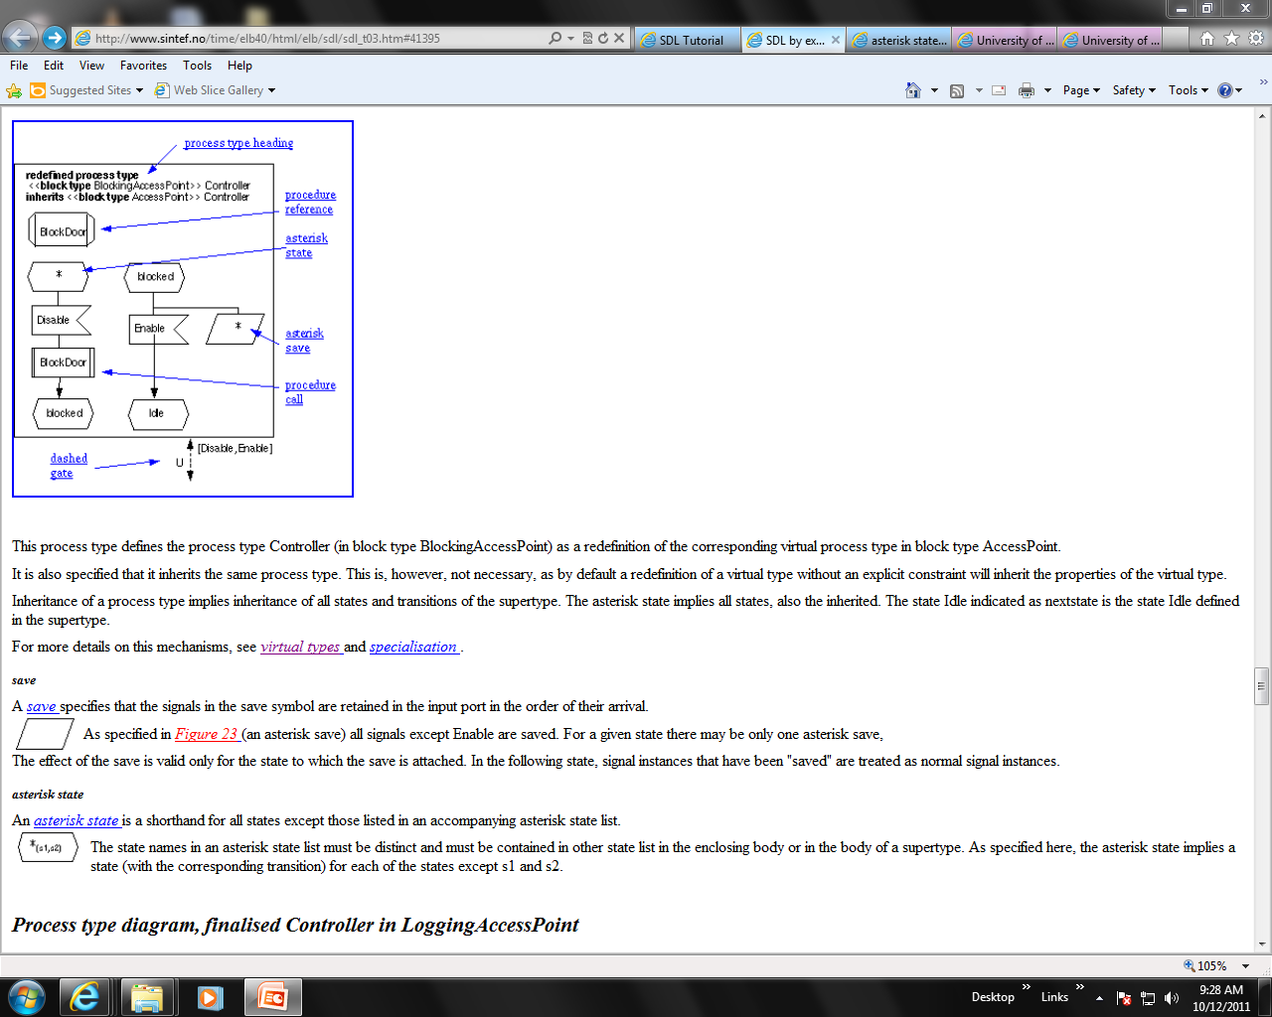
Process type diagram, redefined Controller in BlockingAccessPoint
The asterisk state implies all states, also the inherited
An asterisk state is a shorthand for all states except those listed in an accompanying asterisk state list.
A save specifies that the signals in the save symbol are retained in the input port in the order of their arrival

Slide 23
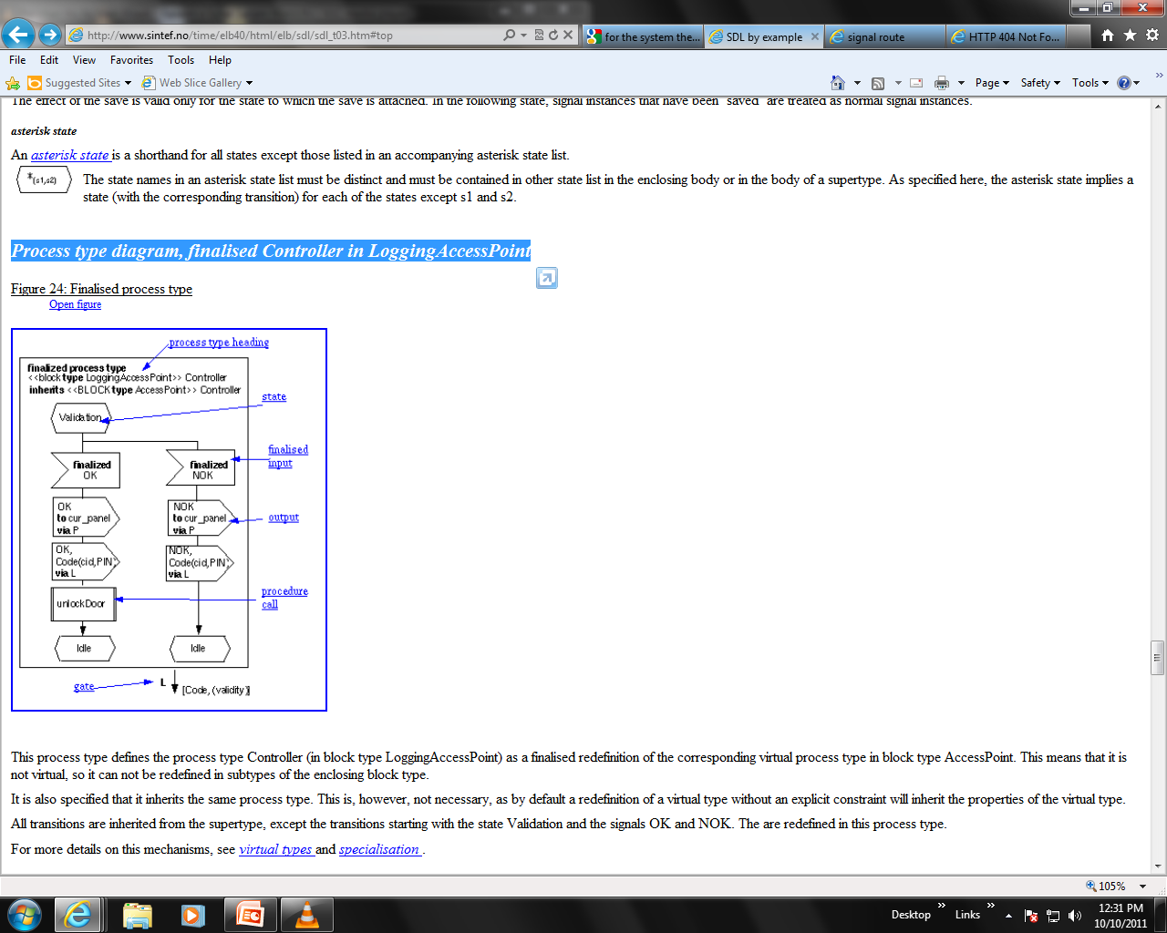
Process type diagram, finalised Controller in LoggingAccessPoint

Slide 24
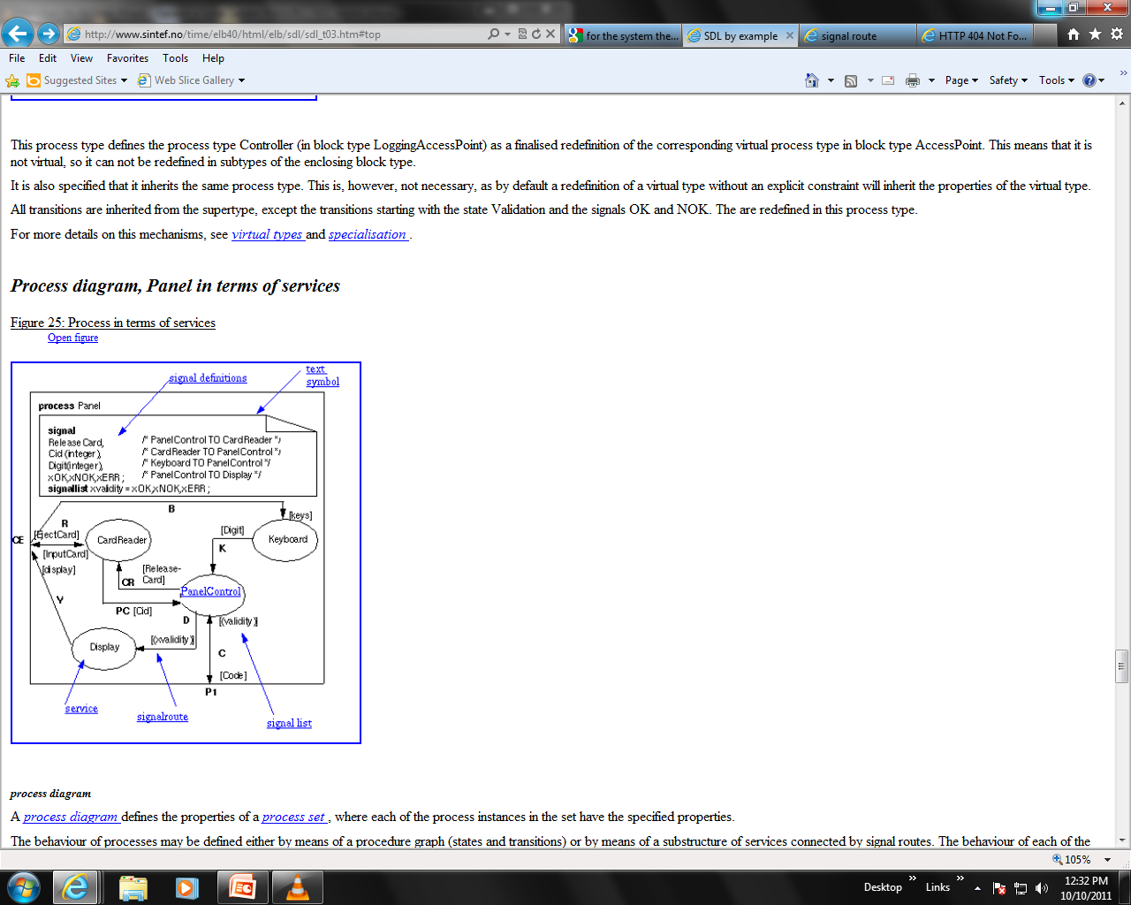
Process diagram, Panel in terms of services

Slide 25
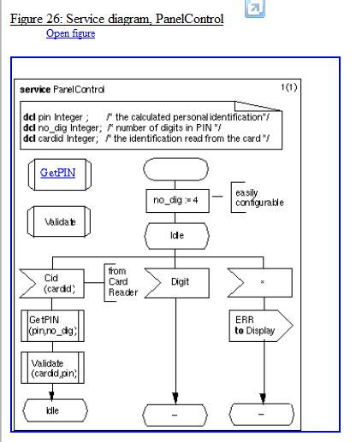
Service diagram, PanelControl

Slide 26
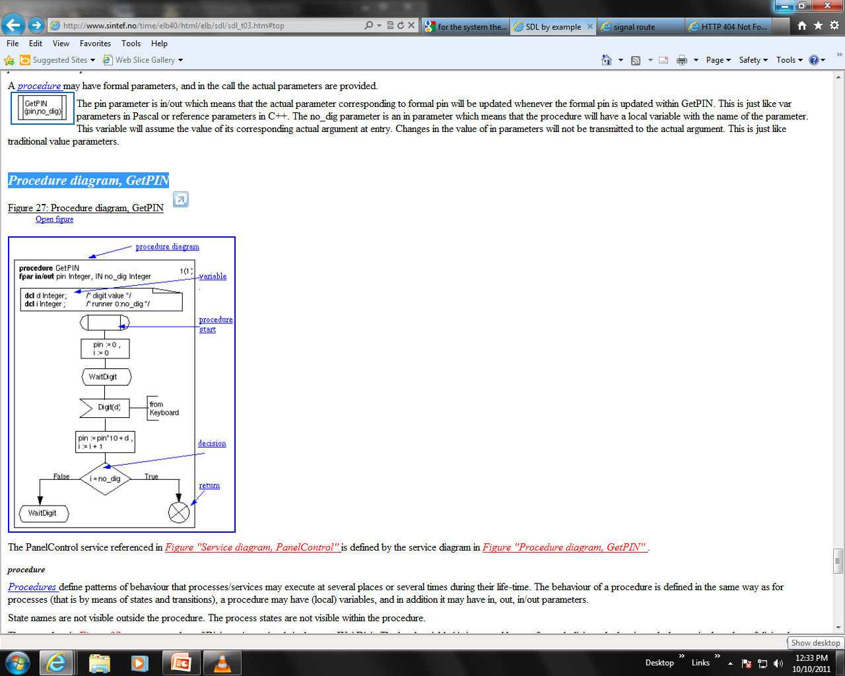
Procedure diagram, GetPIN

Slide 27
Object
As part of object modeling, components of the real world systems are identified and selected properties are described.
These components are modeled by objects.
Objects may be classified into categories of objects (modeled by classes) and into subcategories (modeled by subclasses).
The corresponding is done in SDL, just in other terms: SDL systems consist of instances. The classification of components into categories and subcategories is in the SDL system represented by types and subtypes of instances

Slide 28
Reference
SDL Tutorial
http://www.sintef.no/time/elb40/html/elb/sdl/sdl_t01.htm

